Slide 1
Smart Home
Analysis

Slide 2

+ Internet Dependency
Countries across the coast of West, Central and southern Africa are suffering slow internet connectivity, experiencing reduced speed on international browsing and since, dependency on the internet is one of the major disadvantages of smart home technology. Because of this, the use of smart home technology have been greatly affected in some regions of Africa.

Slide 3
New functionalities
GSM/GPRS Module
functions
The Global System for mobile communication (GSM) and General Packet Radio Service (GPRS) are one of the commonly used communication modules in embedded systems. The GSM Module will be used to enable communication between a microcontroller and the GSM / GPRS Network.
GSM module allow microcontroller to have a wireless communication with other devices and instruments. Such wireless connectivity of microcontroller opens to wide range of applications like;
Home Automation
Home Security Systems, etc.

Slide 4
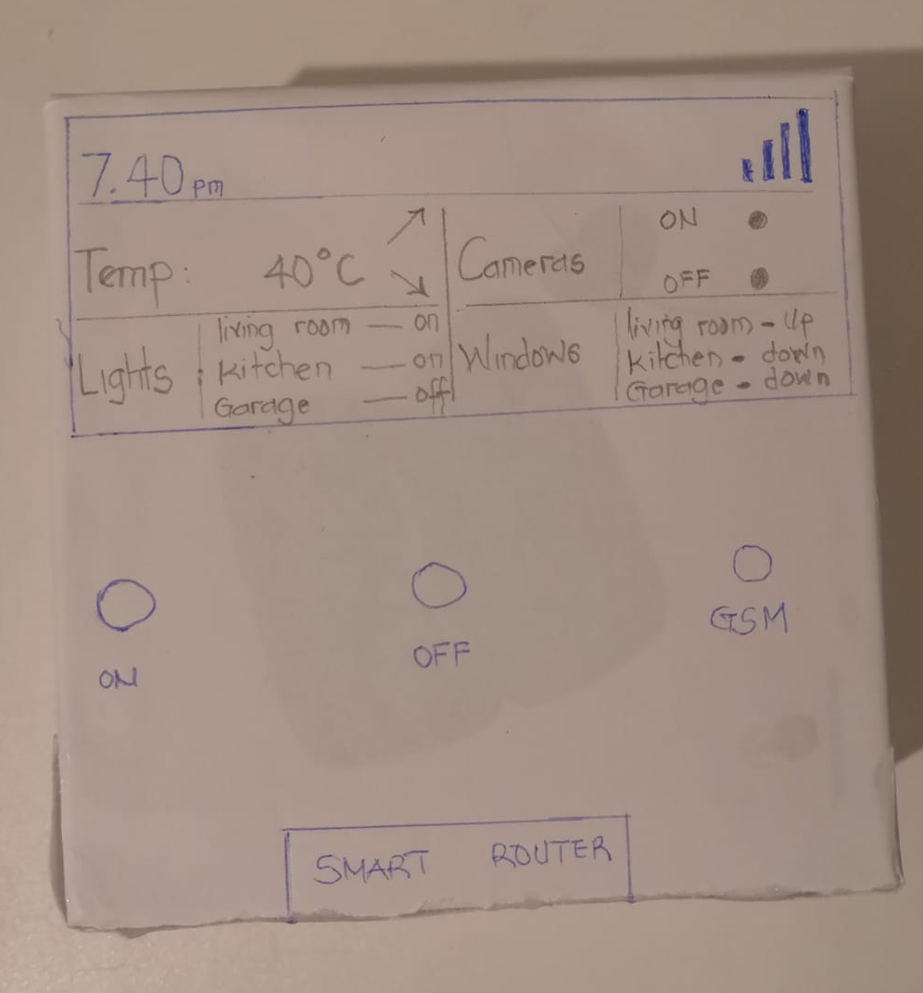
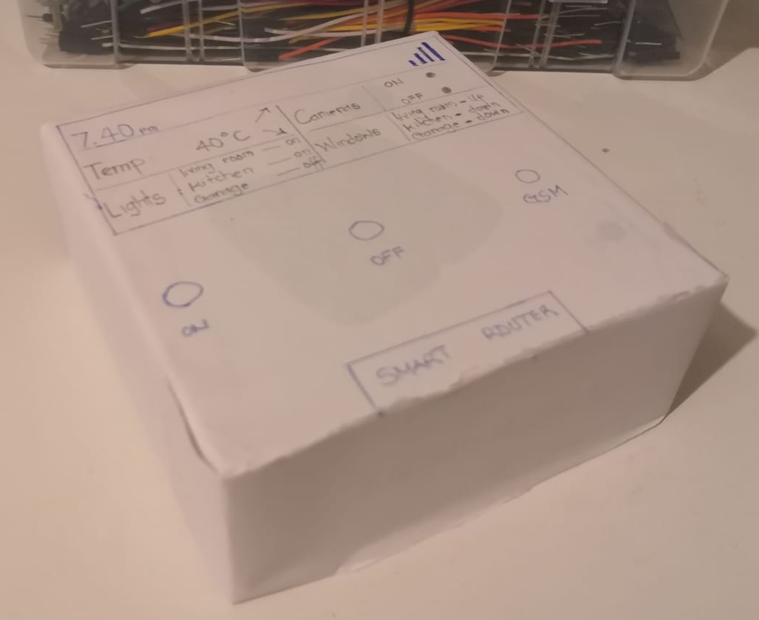
GSM / GPRS Module Router
This GSM GPRS Router comprises of a GSM GPRS Module along with some other components like communication interface, with the help of this communication interface, we can connect the GSM GPRS Module on the GSM GPRS Router with an external computer
Prototype

Slide 5

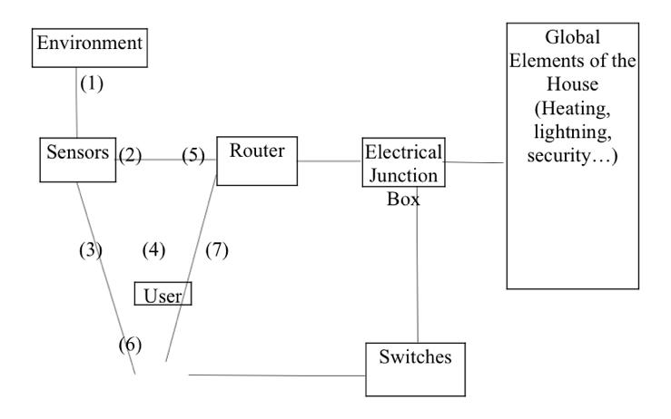
Sketch of architecture
Informations coming from the environment ( weather, bad lightening, intrusion …)
Informations from the sensors and given to the router for analysis
Informations given to the user (mobile application)
Actions made by the user by the mobile application
Processed information by the router and sent to the Junction box
Manual actions by the user in case of defective automatic system
Actions from the switches to the junction box
Interaction between the junction box and each element of the house

Slide 6
Thank You

